Slide 1
COMP6115 Object Oriented Analysis and Design Session #7

Slide 2
Moving on to Design

Slide 3
Learning Outcomes
LO1: Identify the basic concept of advance topic in
Object Oriented Analysis and Design
LO2 : Use the knowledge to develop documentation
for object oriented software analysis and
design using Unified Modelling Language
LO3 : Analyze any problem in any software
application and find out the alternative
solutions using object oriented analysis and
design approach

Slide 4
Chapter 7: Moving on to Design

Slide 5
Learning Objectives
Understand the verification and validation of the analysis models.
Understand the transition from analysis to design.
Understand the use of factoring, partitions, and layers.
Be able to create package diagrams.
Be familiar with the custom, packaged, and outsource design alternatives.
Be able to create an alternative matrix.

Slide 6
Introduction
Analysis determines the business needs
Design activities focus on how to build the system
Major activity is to evolve the models into a design
Goal is to create a blueprint for the design that makes sense to implement
Determine how and where data will be stored
Determine how the user will interface with the system (user interface, inputs and outputs)
Decide on the physical architecture
Analysis and design phases are highly interrelated and may require much “going back and forth”
Example: prototyping may uncover additional information

Slide 7
The Design Process
Verify and validate the analysis models
Evolve the analysis models into design models
Create packages and utilize package diagrams
Decide upon a design strategy

Slide 8
Verifying & Validating the Analysis Models
Do the analysis models accurately represent the problem domain?
Test the fidelity of each model
Example: activity diagrams, use-case descriptions and use-case diagrams should all describe the same functional requirements
Balance the models to ensure consistency between them

Slide 9
Balancing Functional & Structural Models
A class on a class diagram must be associated with at least one use-case
An activity in an activity diagram and an event in a use-case description should be related to one or more operations on a class diagram
An object node on an activity diagram must be associated with an instance or an attribute on a class diagram
An attribute or an association/aggregation relationship on a class diagram should be related to the subject or object of a use-case

Slide 10
Balancing Functional & Behavioral Models
Sequence & communication diagrams must be associated with a use-case
Actors on sequence & communication diagrams or CRUDE matrices must be associated with actors within a use-case
Messages on sequence & communication diagrams, transitions on behavioral state machines and entries in a CRUDE matrix must relate to activities on an activity diagram and events in a use-case
All complex objects in activity diagrams must be represented in a behavioral state machine

Slide 11
Balancing Structural & Behavioral Models
Objects in a CRUDE matrix must be associated with classes
Behavioral state machine must be associated with objects on a class diagram
Objects in sequence and communication diagrams must be associated with objects on a class diagram
Messages on sequence and communication diagrams and transitions on behavioral state machines must be associated with operations in a class
States in a behavioral state machine must match the different values of an attribute of an object

Slide 12
Evolving the Analysis Models into Design Models
Analysis models focused on functional requirements
Design models must include non-functional requirements as well
System performance
System environment issues
Distributed vs. centralized processing
User interface
Database
The system must be maintainable and affordable, efficient and effective
Utilize factoring, partitions & collaborations, and layers

Slide 13
Factoring
Creating modules that account for similarities and differences between units of interest
New classes formed through a:
Generalization (a-kind-of) relationship, or a
Aggregation (has-parts) relationship
Abstraction—create a higher level class (e.g., create an Employee class from a set of job positions)
Refinement—create a detailed class (e.g., create a secretary or bookkeeper from the Employee class)

Slide 14
Partitions and Collaborations
Partition: create a sub-system of closely collaborating classes
Base partitions on patterns of activity (e.g., collaborations found in a communication diagram)
Greater coupling among classes may identify partitions (e.g., more messages passes between objects suggests that they belong in the same partition)
Identifying partitions and collaborations determines which classes should be grouped together

Slide 15
Layers
System environment information must now be added
Use layers to represent and separate elements of the software architecture
Easier to understand a complex system
Example:
Model-view-controller (MVC) architecture
Separates application logic from user interface
Proposed layers:
Foundation (e.g., container classes)
Problem domain (e.g., encapsulation, inheritance, polymorphism)
Data management (e.g., data storage and retrieval)
User interface (e.g., data input forms)
Physical architecture (e.g., specific computers and networks)

Slide 16
Packages and Package Diagrams
Packages group together similar components (e.g., use-cases, class diagrams)
Package diagrams show the packages and their relationships
Aggregation & association relationships are possible
Packages may be dependent upon one another
If one package is modified, others that depend on it may also require modification

Slide 17
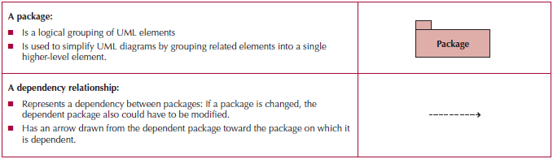
Package
A general construct that groups units together
Used to reduce complexity of models
A package diagram shows packages only

Slide 18
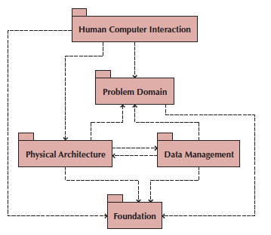
Sample Package Diagram

Slide 19
Guidelines for Building Package Diagrams
Use them to logically organize your design
Observe semantic relationships
Vertical positioning indicates inheritance
Horizontal positioning indicates aggregation and association
Dependency relationships should also observe semantic relationships
For use-case package diagrams, include the actors
Use simple but descriptive names for each package
Make packages cohesive

Slide 20
Building Package Diagrams
Set the context
Cluster classes together based on shared relationships
Create packages from the clusters
Identify dependency relationships among packages
Lay out and draw the diagram including only the packages and their dependencies
Verify and validate the package diagram

Slide 21
Design Strategies
Custom development—build it in house from scratch
Purchase packaged software
Office suites (e.g., word processors, spreadsheets, etc.)
Enterprise systems (e.g., SAP, PeopleSoft)
Hire an external vendor (outsource)

Slide 22
Custom Development
Allows for meeting highly specialized requirements
Allows flexibility and creativity in solving problems
Easier to change components
Builds personnel skills
May excessively burden the IT staff
May add significant risk

Slide 23
Packaged Software
Software already written (e.g., accounting software)
May be more efficient
May be more thoroughly tested and proven
May range from components to tools to entire enterprise systems
Must accept functionality provided
May require change in how the firm does business
May require significant “customization” or “workarounds”

Slide 24
System Integration
Building a new system by combining packages, legacy systems, and new software
Not uncommon to purchase off the shelf software and outsource its integration to existing systems
Key challenge is integrating data
May require data transformations
New package may need to write data in the same format as a legacy system
Develop “object wrappers”
Wraps the legacy system with an API to allow newer systems to communicate with it
Protects the investment in the legacy system

Slide 25
Outsourcing
Hire an external firm to create the system
Requires extensive two-way coordination, information exchange and trust
Disadvantages include loss of control, compromise confidential information, transfer of expertise
Carefully choose your vendor
Carefully prepare the contract and method of payment
Contract types:
Time-and-arrangement: pay for all time and expenses
Fixed-price: pay an agreed upon price
Value-added: pay a percentage of benefits

Slide 26
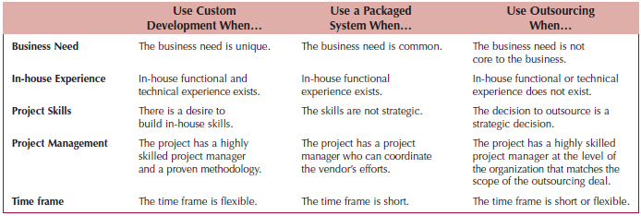
Selecting a Design Strategy

Slide 27
SELECTING AN ACQUISITION STRATEGY
Determine tools and skills needed for in-house development
Identify existing packages that satisfy the users’ needs
Locate companies who can build it under contract
Create an alternative matrix to organize the pros and cons of each possible choice
Incorporate technical, economic and organizational feasibility
Utilize an RFP or RFI to obtain cost & time estimates from potential vendors

Slide 28
Summary
Verifying and Validating the Analysis Models
Evolving the Analysis Models into Design Models
Packages and Package Diagrams
Design Strategies
Developing the Actual Design

Slide 29
References
Denis, Wixom,Tegarden. (2015). Systems Analysis and Design: An Object-Oriented Approach with UML. 5th edition. ISBN: 978-1-118-80467-4, John Wiley & Sons, Inc, Denver (USA)

